Slide 1
Project Name : Western Countries Financial Dataset
By :
PAWAR SANKET
Business Analyst Career Program - Capstone Project

Slide 2

Agenda
Data Exploration
Statistical Analysis using Excel
Graphical Analysis using Excel
Insert the given data into the SQL server
Import the Data from the SQL Database into PowerBI
Interactive Dashboard by using visualization tools
Conclusion and Inferences
Endnotes

Slide 3
Summary
`1) Government Segment Dominates: The Government Segments have the Highest Sales and Profit whereas Enterprise appears to have the Profit numbers in Negative.
2) Carretera Product Popular : Carretera is the most frequently sold product compare to other product.
3)Varying Profit Margin : Profit margin varies according to the product s
old as well as the sales happened in the particular time span.
4) Paseo product Dominates the COGS: The Paseo product seems to be the highest in Cost of Goods Sold (27.62M).
5) Discount Band “None” Prevalent : Most sales do not involve discount .

Slide 4
Statistical Analysis using Excel
Units Sold : The Average Units Sold is 1608
Sales : Canada Produced the Highest Sales 24887655
Total Sales : Total Sales generated was 118726350
Profit Month : October was the Highest profitable month across the year with the profit of 3.4 M
Profit : The Profit earned was around 16.89 M

Slide 5
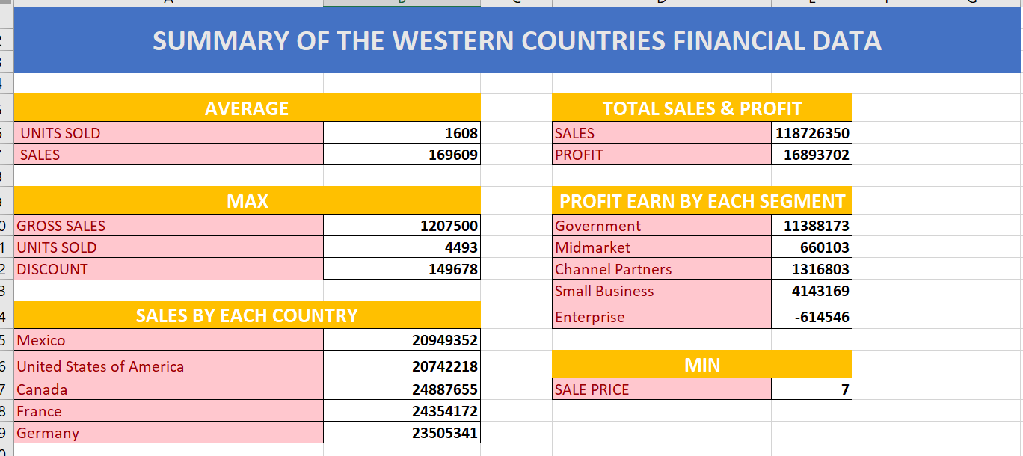
Graphical Analysis using Excel
Insert the relevant screenshots and give brief summary about the Graphical Analysis using Excel

Slide 6
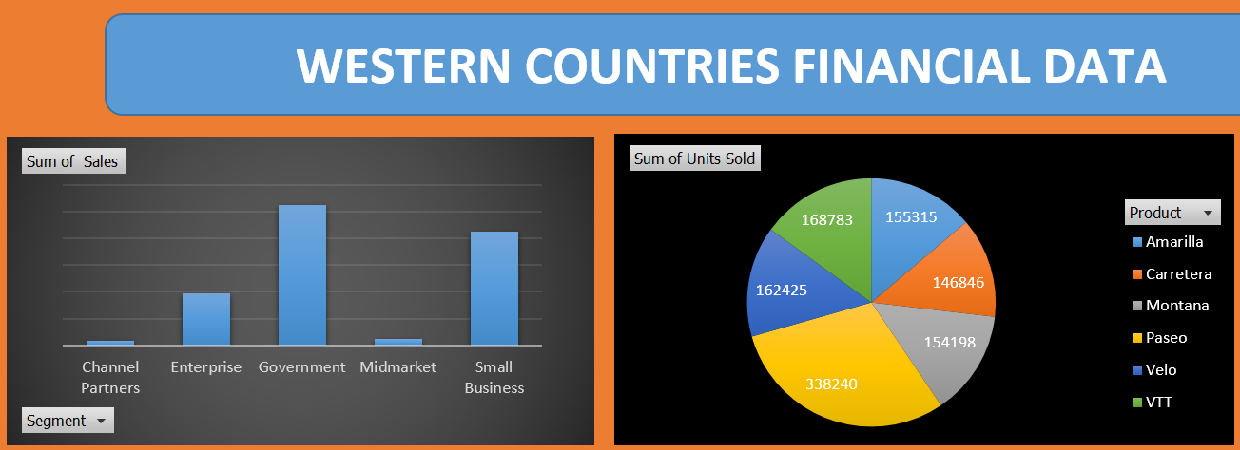
Graphical Analysis using Excel
Insert the relevant screenshots and give brief summary about the Graphical Analysis using Excel

Slide 7
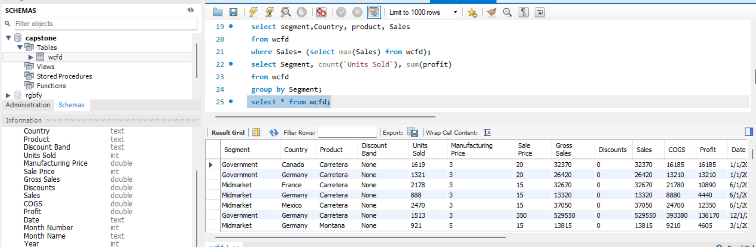
Insert the given data into the SQL server
Insert the relevant screenshots verifying that the data is successfully inserted into a SQL DB. Run a basic Queries on Data.

Slide 8
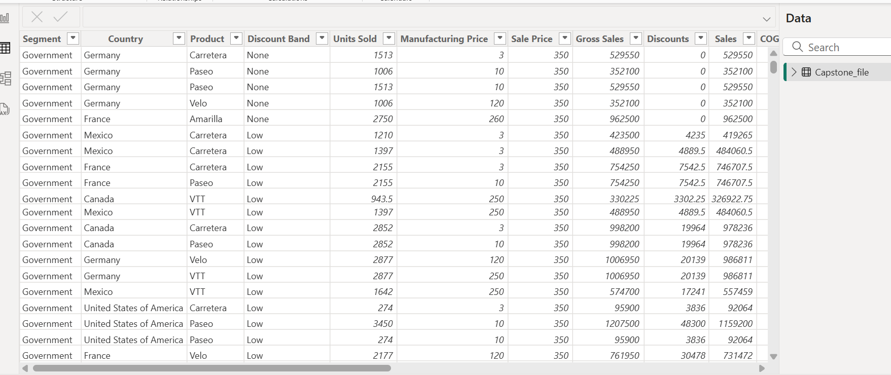
Import the Data from the SQL Database into PowerBI
(This is a dummy “about us” section)
Insert the relevant screenshots verifying that the data is successfully inserted into PowerBI and do the required data cleaning or creation of measured for data analysis

Slide 9
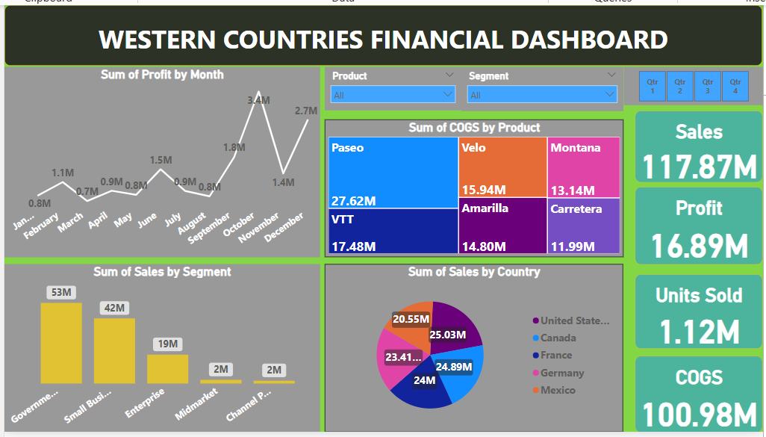
Interactive Dashboard by using visualization tools
(This is a dummy “about us” section)
Insert the relevant screenshots of the Dashboard made using Visualization tools such as PowerBi , Make a beautiful Dashboard that shows visually appealing graphs and data analysis.

Slide 10
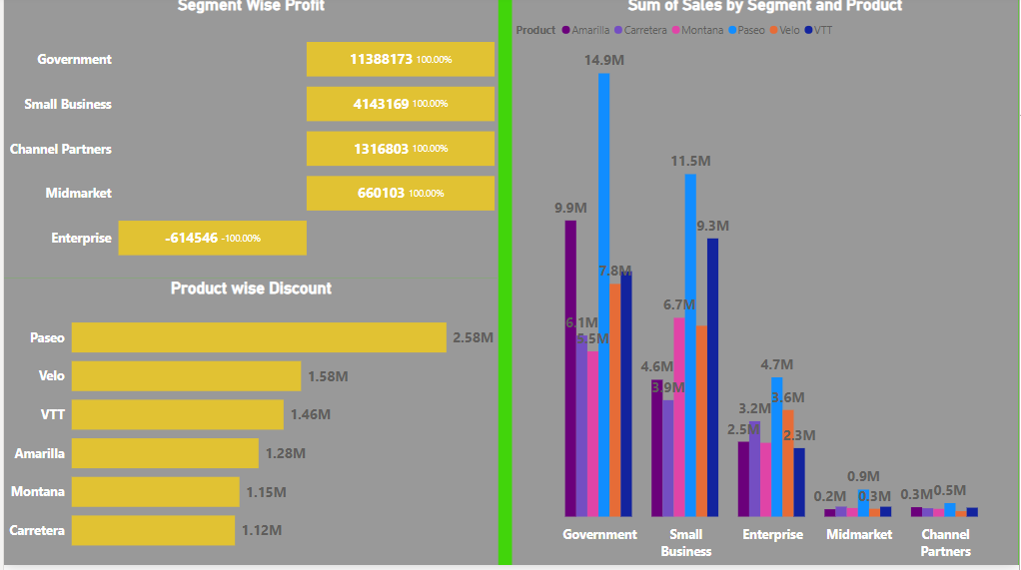
Visuals from the dashboard
(This is a dummy “about us” section)
Submit your conclusion and Inferences on Data after doing statistical and Graphical analysis using Excel and Visualization tools (PowerBI).

